Slide 1
Customer Segmentation using K-Means, DBSCAN, and Hierarchical Clustering
Gauranga Kumar Baishya (MDS202325)

Slide 2
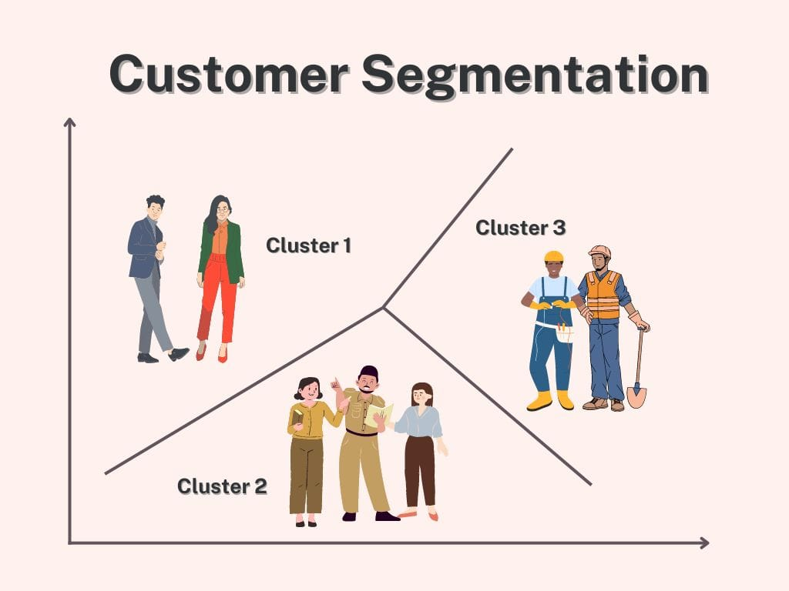
What is customer Segmentation ?
In marketing, market segmentation or customer segmentation is the process of dividing a consumer or business market into meaningful sub-groups of current or potential customers (or consumers) known as segments.
Its purpose is to identify profitable and growing segments that a company can target with distinct marketing strategies.

Slide 3
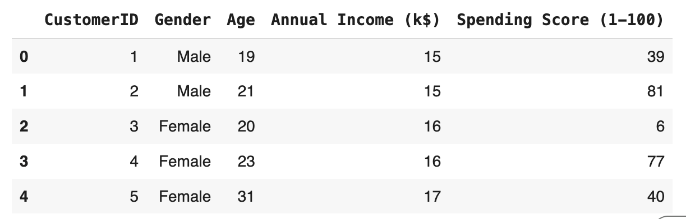
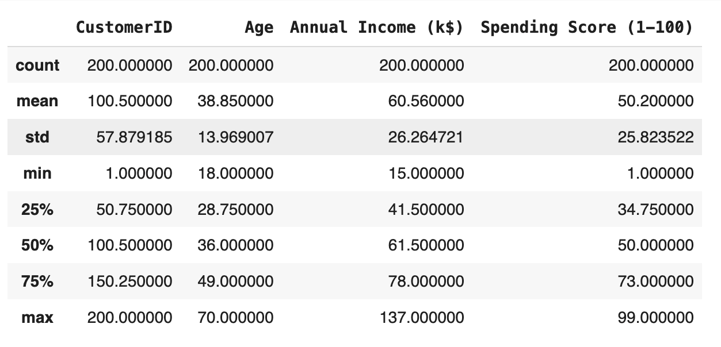
How does the data look like ?

Slide 4
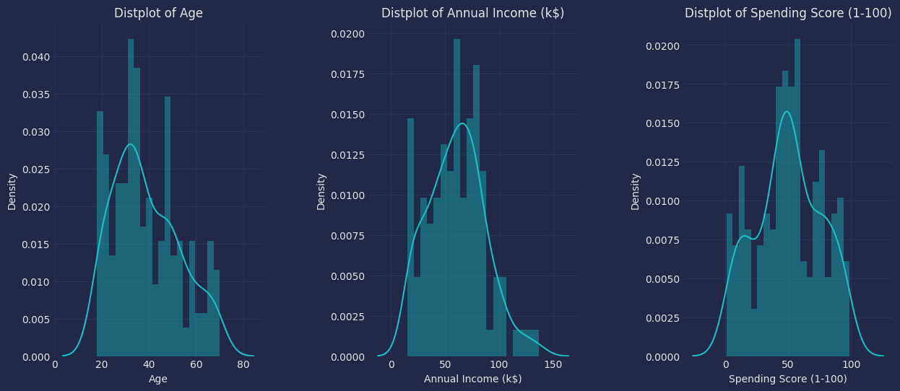
How does the data look like ?

Slide 5
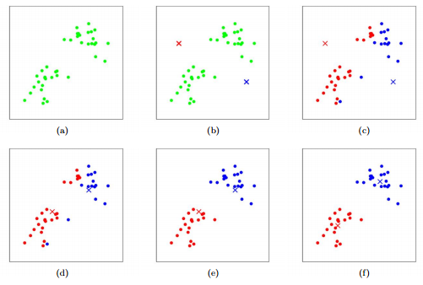
K Means Clustering
Randomly initializing K points.
Each data point is then assigned to the nearest cluster.
The cluster centroids are updated by recalculating their positions using the average of the data points assigned to each cluster.
Steps 2 and 3 are repeated until the centroids do not change significantly.
At the end of the process, we have the clusters.

Slide 6
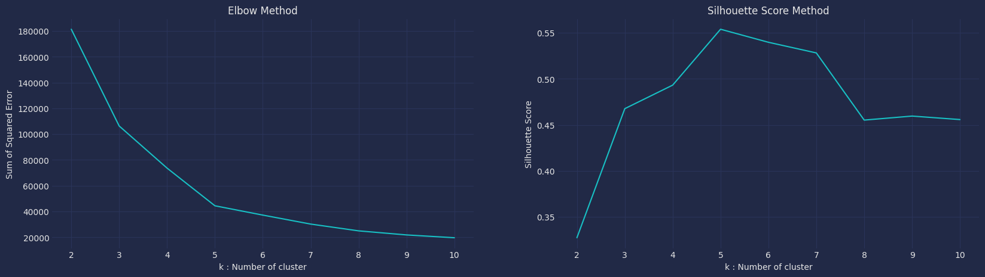
K Means Clustering: Results

Slide 7
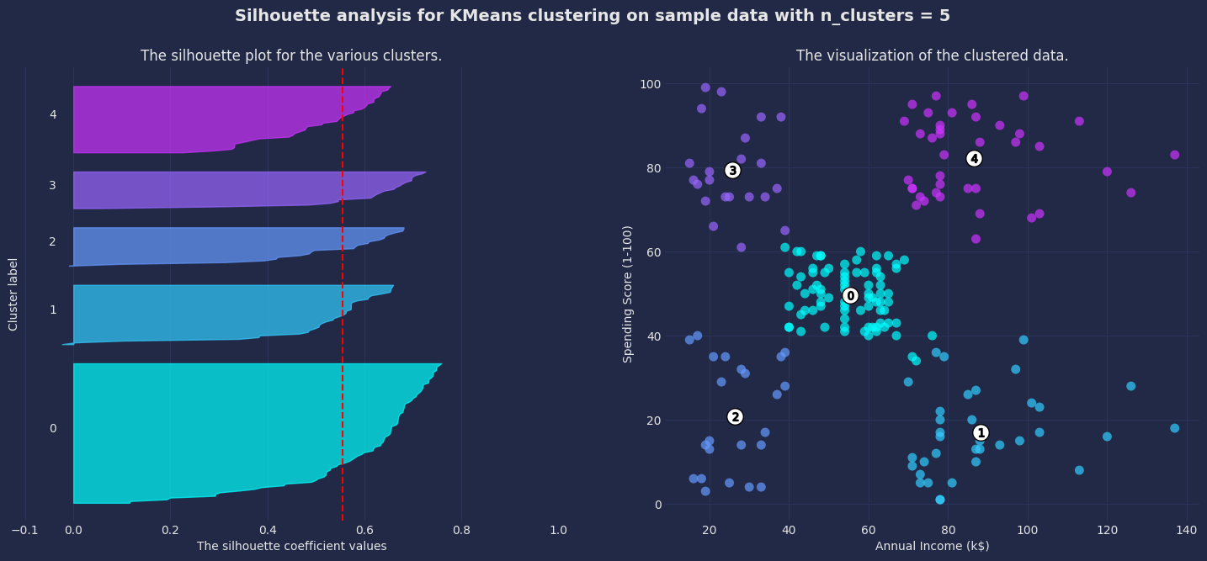
K Means Clustering: Results

Slide 8
K Means Clustering: Results
Segmentation Analysis: Annual Income and Spending Score
The elbow chart suggests 5 clusters, while the silhouette score chart shows the highest value for 5 clusters.
With n_clusters = 5, the silhouette score is 0.5539, indicating a reasonable separation between clusters, and the Davies-Bouldin Index is 0.5726, indicating high cluster quality.
The silhouette plots show consistent thickness across 4 clusters, with one slightly thicker than the others, but overall the clustering appears reasonable.

Slide 9
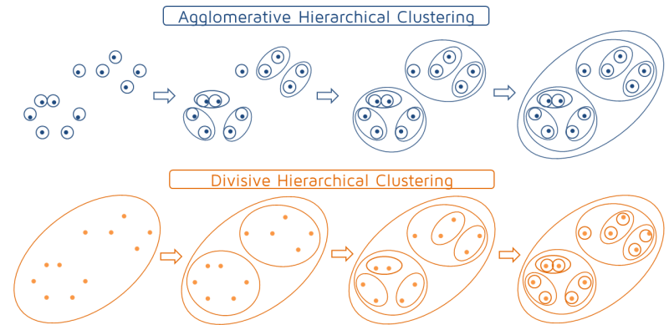
Agglomerative Hierarchical Clustering
Start with each point as a separate cluster.
Find the two closest clusters (based on a distance metric, like Euclidean distance).
Merge the closest clusters into one.
Repeat the process: continue finding and merging the closest clusters until all points are in one single cluster, or until a predefined number of clusters is reached.

Slide 10
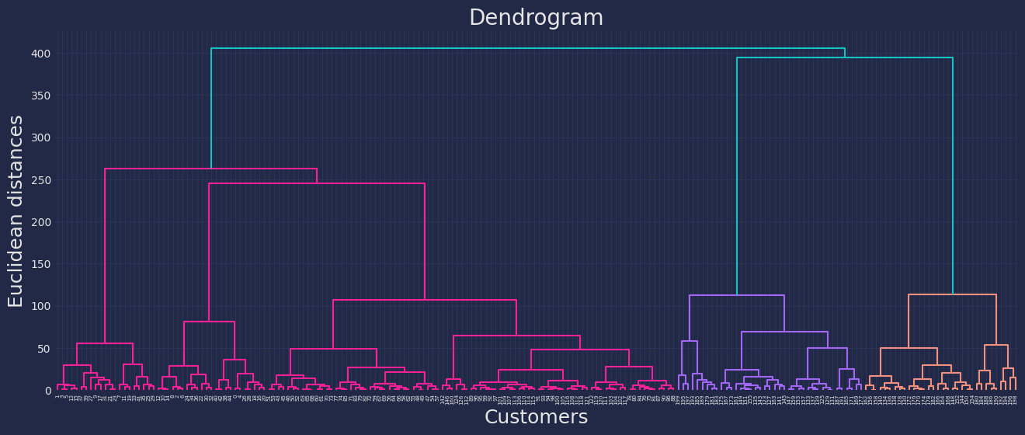
Agglomerative Hierarchical Clustering: Results

Slide 11
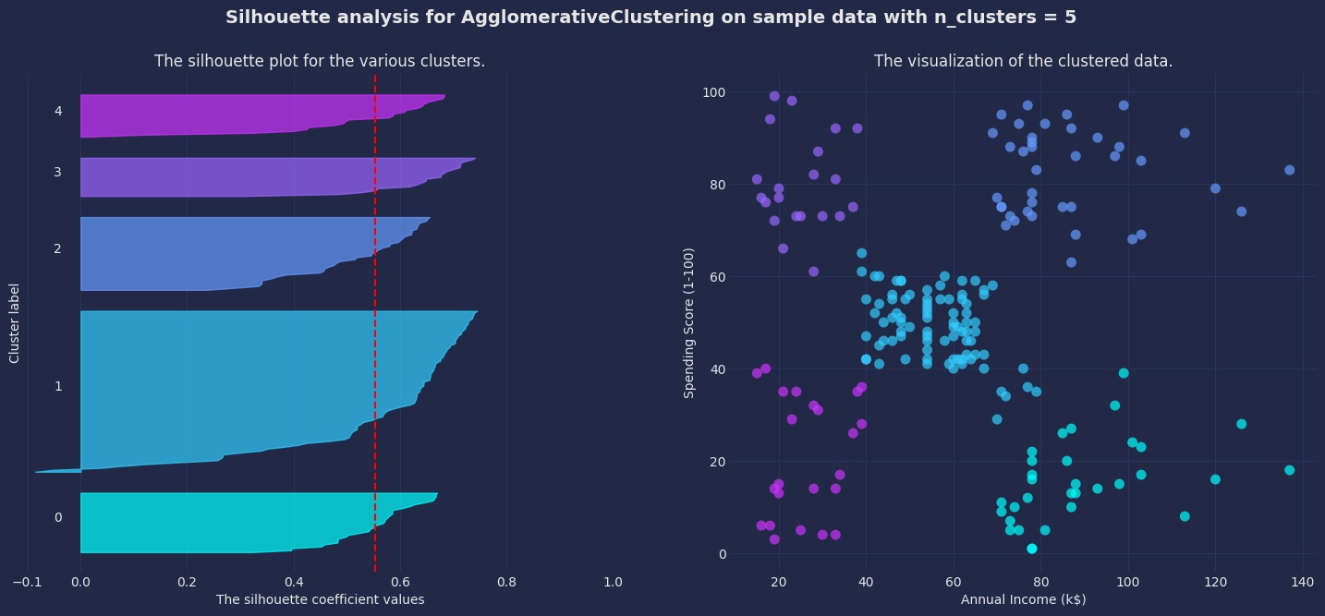
Agglomerative Hierarchical Clustering: Results

Slide 12
Agglomerative Hierarchical Clustering: Results
Segmentation Analysis using Agglomerative Clustering: Annual Income and Spending Score
With n_clusters = 5, the silhouette score is 0.5530, showing that clusters are reasonably separated, and the Davies-Bouldin Index is 0.5782, indicating high cluster quality.
The silhouette plots have consistent thickness across four clusters, with one being slightly thicker, but the clustering appears to be reasonable overall.
In the dendrogram, the threshold level for identifying the ideal number of clusters based on Euclidean distance is found to be around 120 of 400.

Slide 13
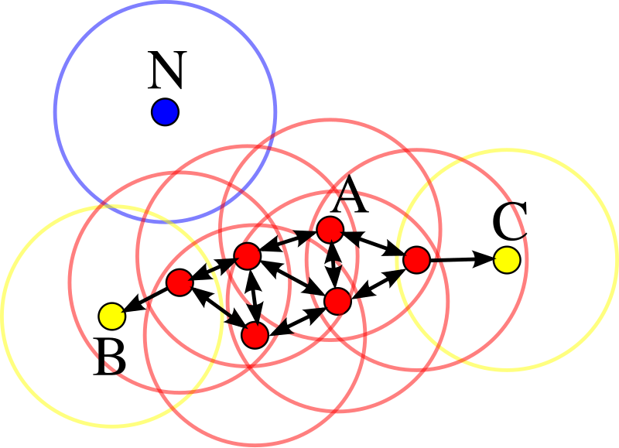
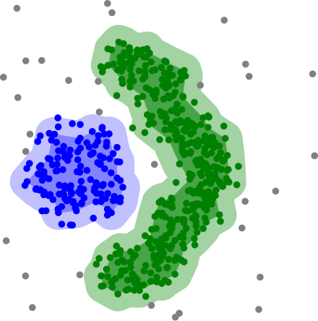
DBSCAN (Density-based spatial clustering of applications with noise)
Choose two parameters:
ε (epsilon): the maximum distance between two points.
MinPts: the minimum number of points required to form a dense region.
Find core points: A core point is a point that has at least MinPts neighbors within a distance of ε.
Expand clusters: Starting from a core point, DBSCAN recursively adds all directly reachable points (points within ε distance) to the same cluster.
Handle noise: Points that do not meet the MinPts threshold in any cluster are marked as outliers (noise).
Repeat for all points: The algorithm continues until all points are assigned to a cluster or marked as noise.

Slide 14
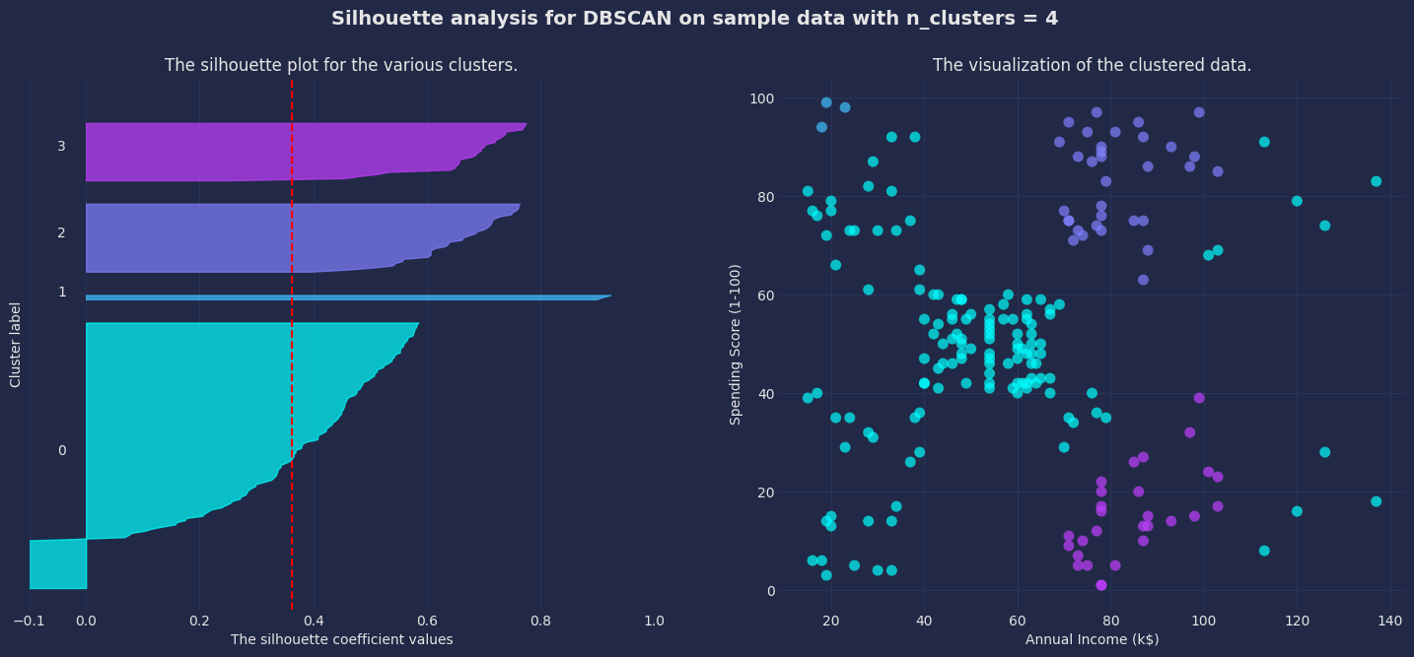
DBSCAN: Results

Slide 15
DBSCAN: Results
Segmentation Analysis using DBSCAN: Annual Income and Spending Score
With n_clusters = 4, the silhouette score is 0.3627, indicating a modest separation between clusters. However, the Davies-Bouldin Index is 0.7540, suggesting suboptimal cluster quality.
The scatter plot shows that the algorithm does not adequately fit the data, with one large cluster and several small ones.
The thickness of clusters in silhouette plots varies, indicating that cluster sizes are inconsistent.
The dendrogram's threshold level for determining the optimal number of clusters based on Euclidean distance is approximately 260 out of 400.

Slide 16
Conclusion
K Means segmentation for Annual Income and Spending Score shown to be the most effective model, with significant cluster separation and good quality (silhouette score: 0.5539).
Agglomerative Clustering produced comparable results but lagged significantly behind KMeans in performance measurements.
DBSCAN demonstrated suboptimal cluster quality and separation, making it less suitable for this dataset.
As a result, for mall consumer segmentation, K Means clustering based on Annual Income and Spending Score remains the recommended method due to its robust and interpretable results.

